Slide 1
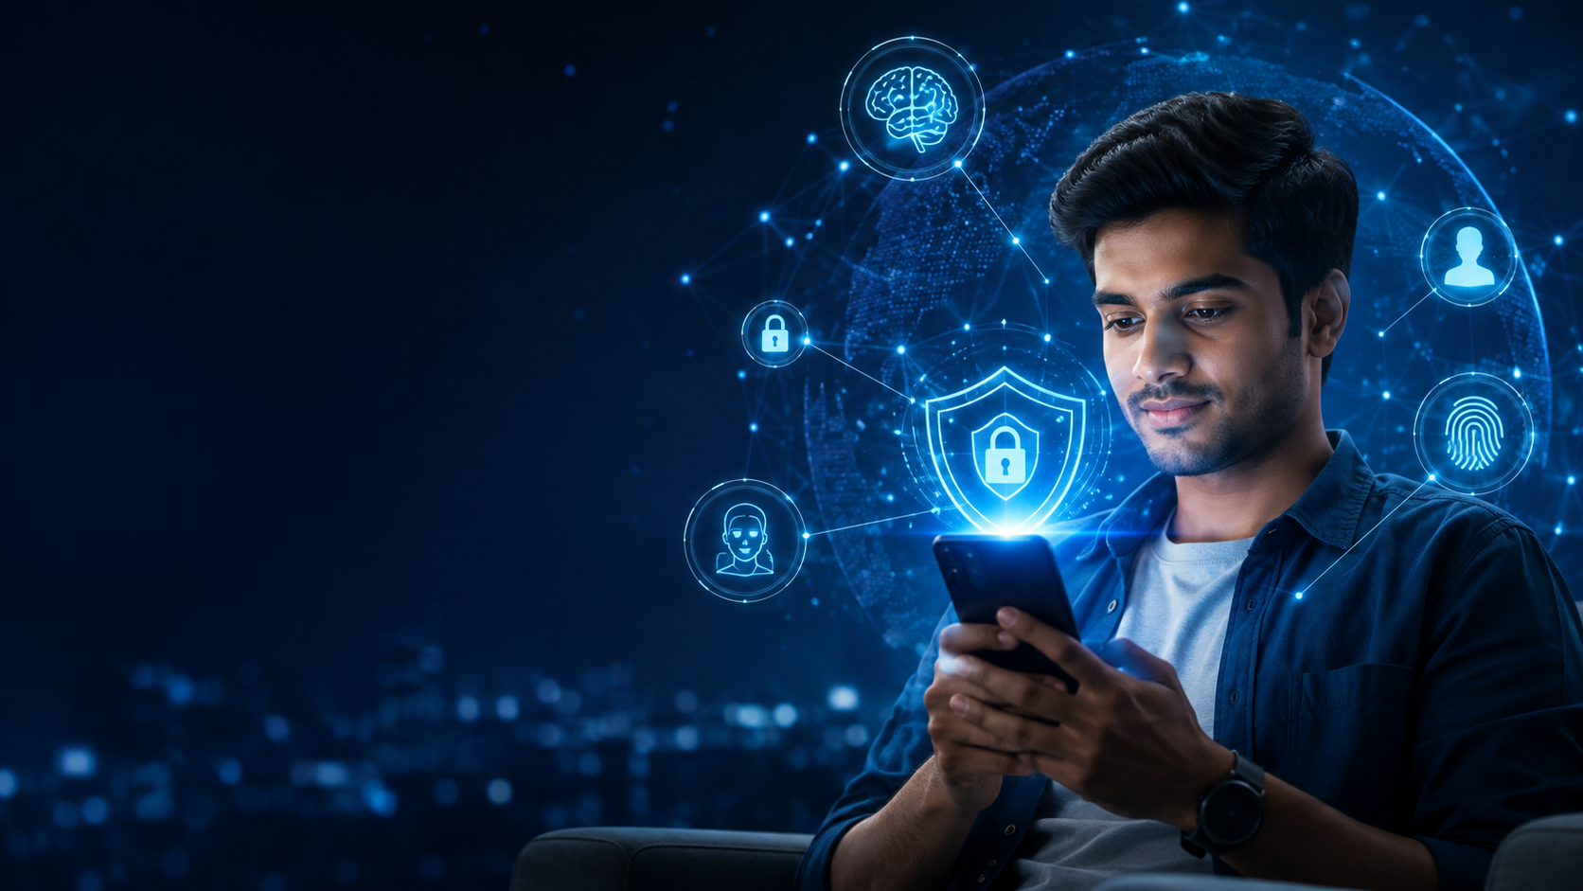
CYBER SMART
Protecting Yourself in an
AI-Powered Digital World
Practical changes for your phone, accounts, systems, social media and AI use.
NAJEEB UL HASSAN
Focal Person & Public Relations Officer • NCCIA
ITQ Certified Trainer • CyberOps • OSINT • Threat Intelligence
Notes:
Opening: Ask, ‘If someone got access to your phone today, how much of your life could they control?’ Do not begin with definitions. Establish that this is a practical workshop.
[Sources]
- AI-generated visual created for this presentation

Slide 2
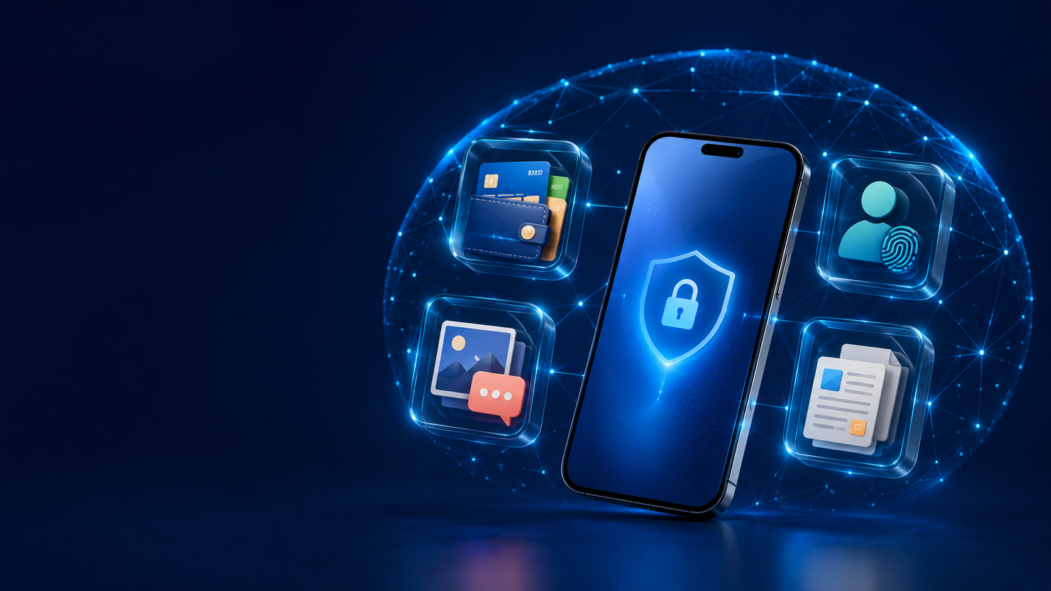
02 • EVERYDAY SECURITY
Your phone is not
just a phone
It is the gateway to almost every part of your digital life.
MONEY
IDENTITY
RELATIONSHIPS
WORK
One device. Four high-value targets.
Notes:
Timing: 6 minutes. Ask participants which area would hurt most if their phone were compromised. Use two or three answers to personalize the stakes.
[Sources]
- AI-generated visual created for this presentation

Slide 3
03 • THE CYBER-SMART MODEL
Five doors protect your digital life
01
02
03
04
05
MOBILE
ACCOUNTS
SYSTEMS
SOCIAL
AI
Secure the device
Protect access
Reduce exposure
Control identity
Share carefully
Security is not one setting. It is a system of habits.
Make every door harder to open.
Notes:
Timing: 5 minutes. Explain the learning journey. AI-powered threats will appear throughout the five doors rather than as a separate catalogue.
[Sources]

Slide 4
04 • PRIVATE SELF-CHECK
YES = 1 POINT
How cyber smart are you today?
01
I reuse at least one important password.
02
My lock screen shows message previews.
03
I have not reviewed active login sessions.
04
My social profile reveals personal details.
05
I upload documents to AI without removing identifiers.
06
My family has no safe word for emergency calls.
Count privately. The goal is improvement—not embarrassment.
Notes:
Timing: 7 minutes. Participants count how many statements are true. Repeat the exercise verbally at the end to show practical improvement.
[Sources]

Slide 5
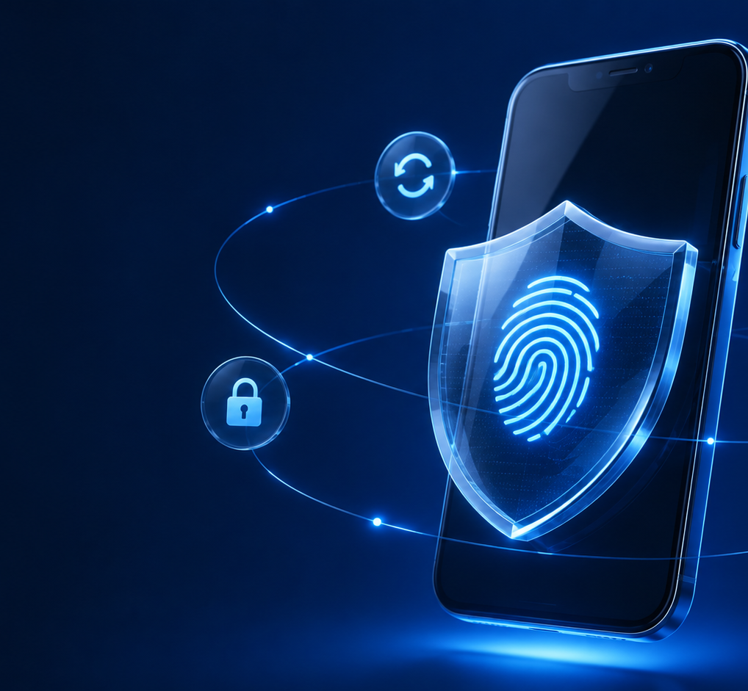
CYBER SMART
Make the phone safe before adding another app
05
✓
Strong screen lock + biometrics
✓
Hide lock-screen previews
✓
Automatic OS and app updates
✓
Review camera, mic and location
✓
Find device + encrypted backup
✓
Official app stores only
Stolen media can power convincing impersonation.
Pause • Verify • Protect
Najeeb ul Hassan
Notes:
Timing: 12 minutes including demonstration. Show lock-screen notification privacy and app permissions on Android/iPhone. Do not expose personal notifications during the demo.
[Sources]
- AI-generated visual created for this presentation

Slide 6
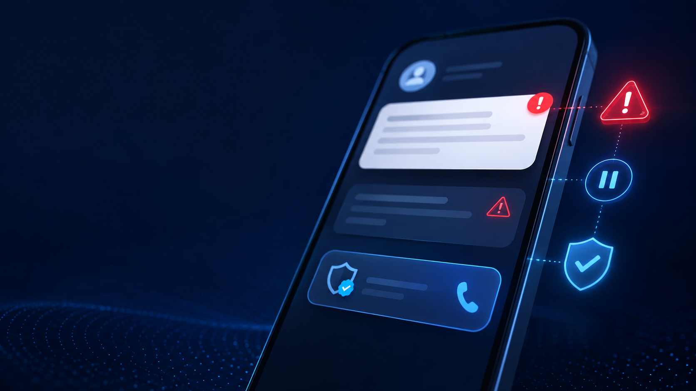
06 • MESSAGES & SOCIAL ENGINEERING
Urgency is a signal
to slow down
1
STOP
Do not click, pay or reply emotionally.
2
CHECK
Inspect the sender, request, link and context.
3
VERIFY
Call back using a saved number or official channel.
4
ACT
Proceed only after independent confirmation.
AI makes scams polished. Verification still works.
Notes:
Timing: 10 minutes. Show a believable WhatsApp or email request. Ask what emotion it targets. Emphasize that a polished message is not proof of legitimacy.
[Sources]
- AI-generated visual created for this presentation

Slide 7
07 • PLATFORM COMPARISON
Secure your social accounts
SETTING
Strongest sign-in option | Passkey / 2-step PIN | Passkey / 2FA | Passkey / 2FA | Passkey / 2FA
Review logged-in devices | Linked Devices | Where logged in | Login activity | Apps & sessions
Unknown-login warning | Security alerts | Login alerts | Login requests | Security alerts
Recovery protection | Email + PIN | Email/phone + codes | Email/phone + codes | Email/phone + codes
Connected app review | Limited | Apps & websites | Apps & websites | Connected apps
App/device lock | Biometric app lock | Device lock | Device lock | Device lock
Encrypted stored backup | Optional E2EE backup | — | — | —
Account checkup | Privacy Checkup | Security Checkup | Accounts Center | Manual review
FIRST PRIORITY • Strongest sign-in + review sessions + secure recovery
Notes:
Timing: 12 minutes. Do not read every cell. Ask the audience to open their most-used platform and locate active sessions. Clarify that feature availability and menu labels can vary by device and rollout.
[Sources]
- https://faq.whatsapp.com/143990998547188
- https://faq.whatsapp.com/490592613091019
- https://www.facebook.com/help/799880743466869
- https://help.instagram.com/566810106808145
- https://help.x.com/en/managing-your-account/how-to-use-passkey

Slide 8
08 • PLATFORM COMPARISON
Control privacy and digital exposure
SETTING
Restrict audience | Status/privacy controls | Post audience | Private account | Protect posts
Unknown contacts | Silence callers | Message controls | Message controls | DM/call controls
Hide IP during calls | Protect IP in Calls | — | — | Enhanced Call Privacy
Spam / harmful words | Block unknown messages | Spam filters | Hidden Words | Mute words / filters
Tags and mentions | Group/status controls | Tag Review | Manual approval | Mention controls
Location exposure | Device permission | Location controls | Location controls | Location controls
Phone/email discovery | Privacy controls | Discoverability | Accounts Center | Discoverability
Content leaving chat | Advanced Chat Privacy | Limited | Limited | Limited
SPECIAL CHECK • WhatsApp and X can mask your IP during calls
Notes:
Timing: 12 minutes. Demonstrate WhatsApp: Settings > Privacy > Advanced > Protect IP address in calls. Explain the possible call-quality tradeoff. Show X Enhanced Call Privacy if available. Also mention WhatsApp Disable Link Previews and Advanced Chat Privacy.
[Sources]
- https://faq.whatsapp.com/2635108359972899
- https://faq.whatsapp.com/3307102709559968
- https://faq.whatsapp.com/715385484388016
- https://help.x.com/en/using-x/direct-messages/audio-video-calls
- https://help.instagram.com/196883487377501
- https://help.x.com/en/safety-and-security/control-your-x-experience

Slide 9
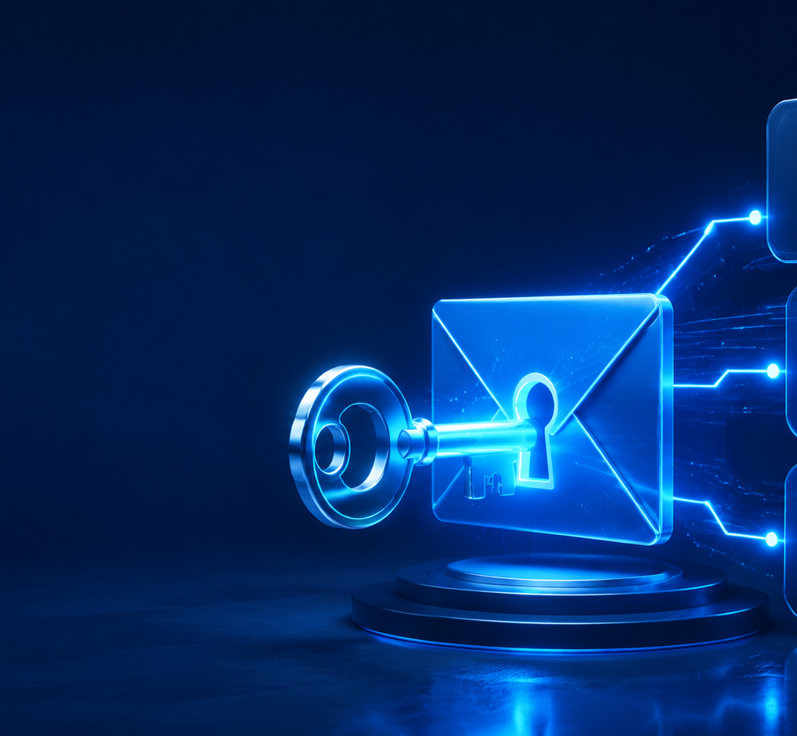
CYBER SMART
Secure email first—it resets everything else
09
PRIMARY EMAIL = MASTER KEY
1
Unique long password or passkey
2
Authenticator-based 2FA
3
Updated recovery email and phone
4
Review sessions and app access
5
Store recovery codes safely
If you improve one account today, improve this one.
Pause • Verify • Protect
Najeeb ul Hassan
Notes:
Timing: 10 minutes. Demonstrate a password manager using a training account, not a personal account. Explain why password reuse allows one breach to spread across many services.
[Sources]
- AI-generated visual created for this presentation

Slide 10
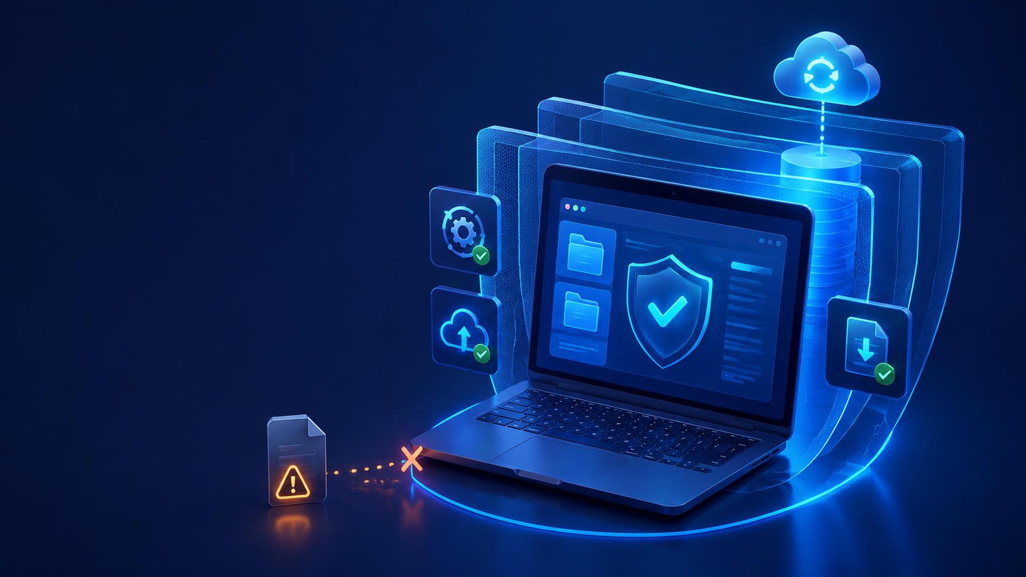
10 • SYSTEMS & BROWSERS
Keep your computer
boring and recoverable
UPDATE
OS • browser • applications
INSTALL
Legitimate software only
DEFEND
Firewall + built-in antivirus
DOWNLOAD
Expected sender + expected file
BACK UP
Important files in two places
LOCK
Screen when stepping away
Professional-looking files can still deliver malware.
Notes:
Timing: 9 minutes. Focus on automatic updates, legitimate software, backups, and unknown USB/file risks. Avoid technical malware taxonomy.
[Sources]
- AI-generated visual created for this presentation

Slide 11
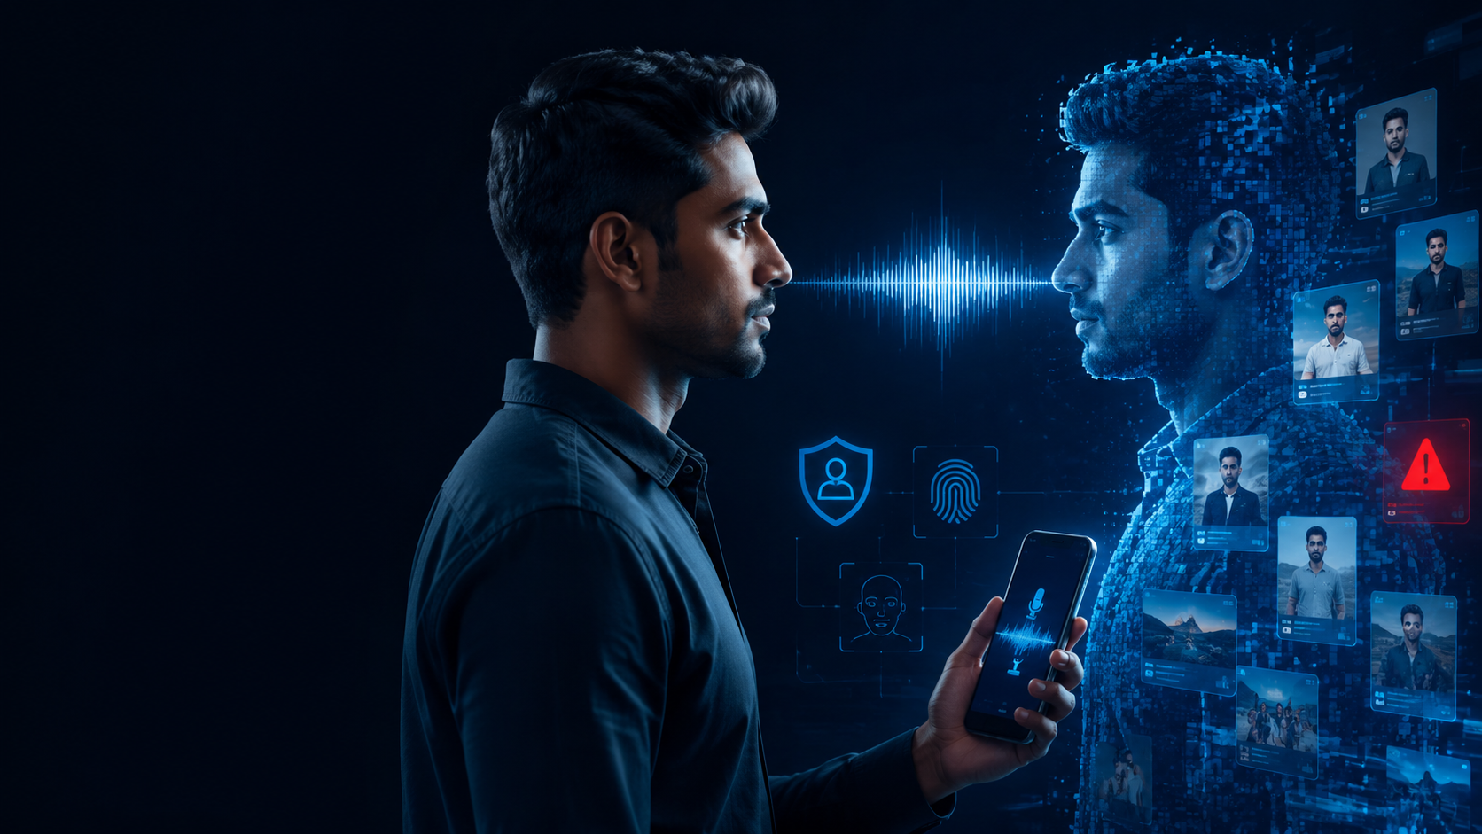
CYBER SMART
Your profile can become an attacker’s research file
11
PUBLIC CLUES
1
Family and workplace
2
Location and routine
3
Face and voice samples
4
Interests and recent events
Familiar is not verified.
Call back on a saved number.
Pause • Verify • Protect
Najeeb ul Hassan
Notes:
Timing: 10 minutes. Explain cloned-voice and impersonation risk. Recommend a family safe word, call-back on a saved number, and a second trusted person for financial emergencies.
[Sources]
- AI-generated visual created for this presentation

Slide 12
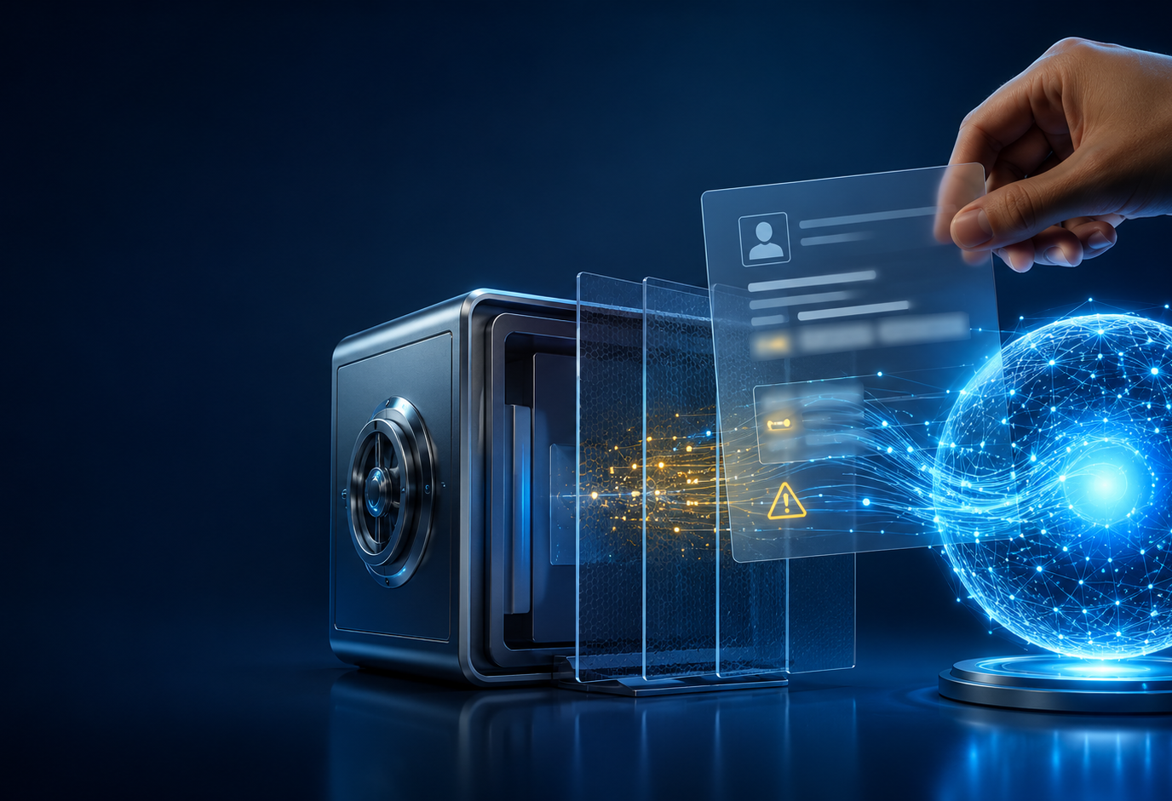
CYBER SMART
Use AI as an assistant—not a confidential vault
12
SAFE
Public information
General questions
Creative ideas
ANONYMIZE
Remove names
Remove identifiers
Confirm approval
NEVER
Passwords or codes
Identity documents
Case, medical or financial data
Remove sensitive details before prompting.
Pause • Verify • Protect
Najeeb ul Hassan
Notes:
Timing: 10 minutes. Use a fictional document to demonstrate anonymization. Remind participants that organizational policy overrides personal convenience.
[Sources]
- AI-generated visual created for this presentation

Slide 13
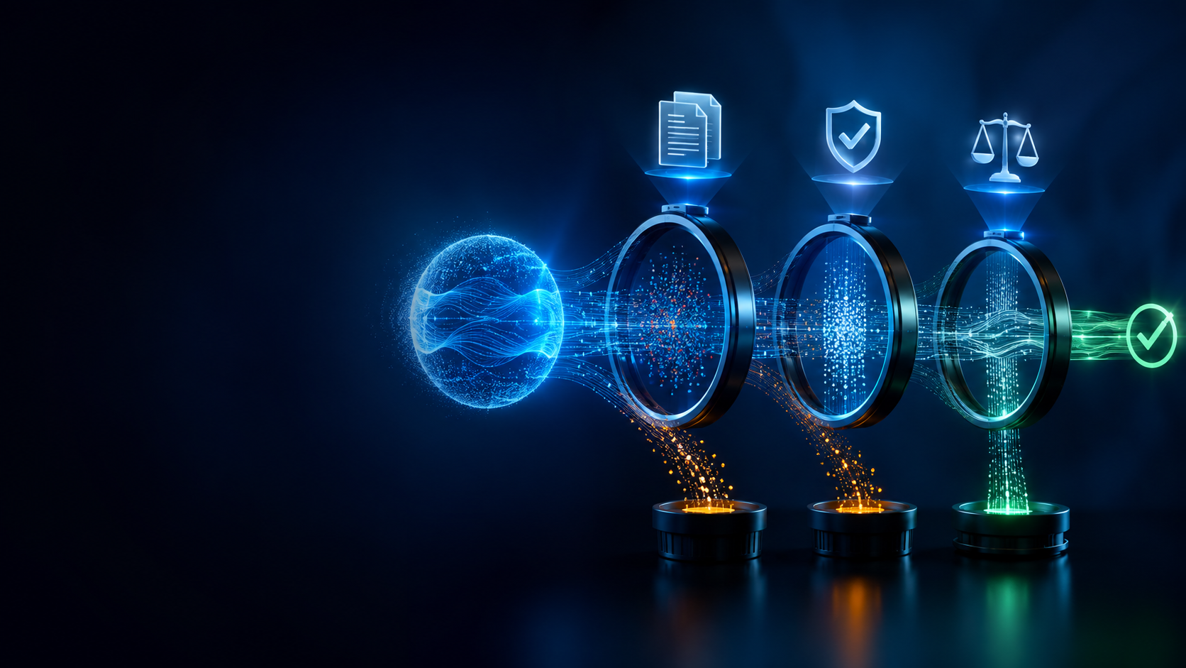
13 • VERIFY AI OUTPUT
Confidence is
not evidence
AI can be useful, convincing—and wrong.
1
SOURCE
Where did this claim originate?
2
CONFIRM
Can a credible independent source verify it?
3
CONSEQUENCE
What happens if this answer is wrong?
Verify high-consequence claims before acting.
Notes:
Timing: 8 minutes. Show one confident but questionable AI response. Ask what source would be needed before acting.
[Sources]
- AI-generated visual created for this presentation

Slide 14
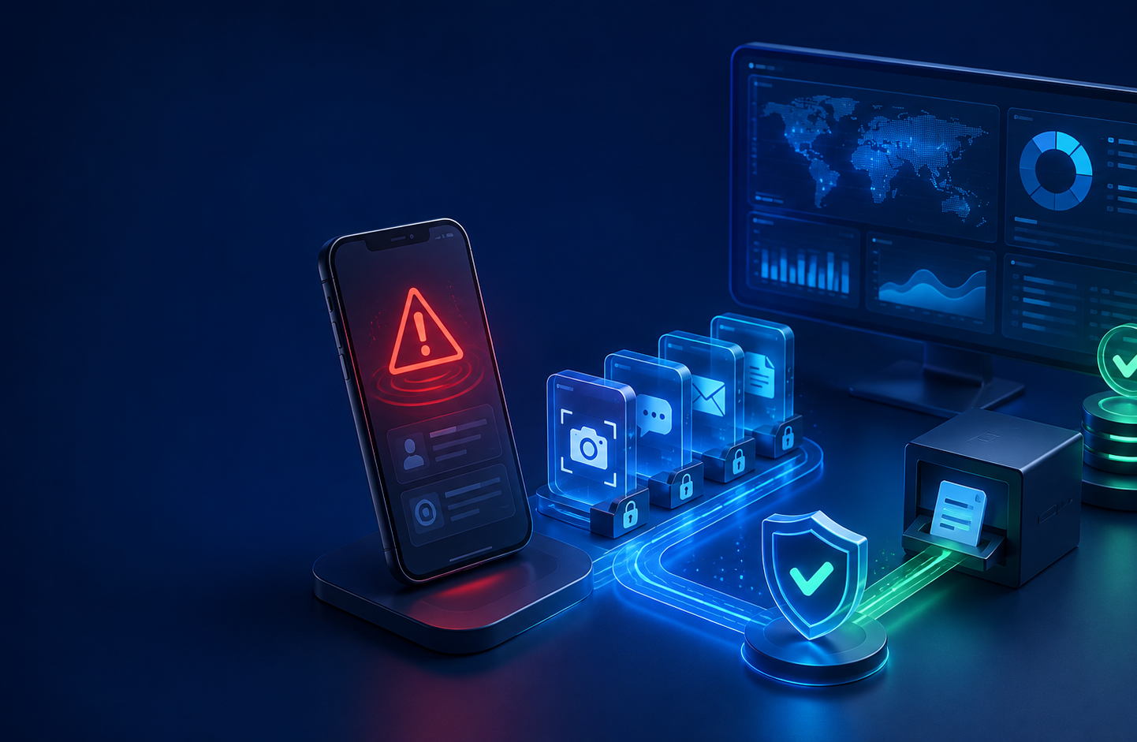
CYBER SMART
When something goes wrong, act quickly—not emotionally
14
1
DISCONNECT
Stop further access
2
SECURE
Change access safely
3
PRESERVE
Keep messages and receipts
4
REPORT
Platform • bank • NCCIA
5
MONITOR
Watch accounts and credit
REPORT: complaint.nccia.gov.pk
24/7 Helpline 1799
Pause • Verify • Protect
Najeeb ul Hassan
Notes:
Timing: 10 minutes. Preserve screenshots, original messages, profile links, numbers, timestamps and transaction IDs before blocking or deleting. For financial fraud, contact the bank/payment provider immediately. Do not promise recovery. Do not encourage hacking back.
[Sources]
- AI-generated visual created for this presentation
- https://complaint.nccia.gov.pk/
- https://www.nccia.gov.pk/

Slide 15
15 • TAKE ACTION
10
MINUTE
CYBER-SMART RESET
Change one setting before you leave.
01
Secure primary email
02
Enable passkey / 2FA
03
Review active sessions
04
Hide lock-screen previews
05
Review app permissions
06
Limit profile information
07
Enable call IP protection
08
Create a family safe word
09
Encrypt important backups
10
Save the NCCIA reporting link
PAUSE • VERIFY • PROTECT
Cyber smart is a habit—not an app.
Notes:
Timing: 15 minutes plus Q&A. Give participants five minutes to change one setting. Invite them to state one action they will take today. Return to the opening self-assessment and ask whether their score can improve now.
[Sources]

